Slide 1
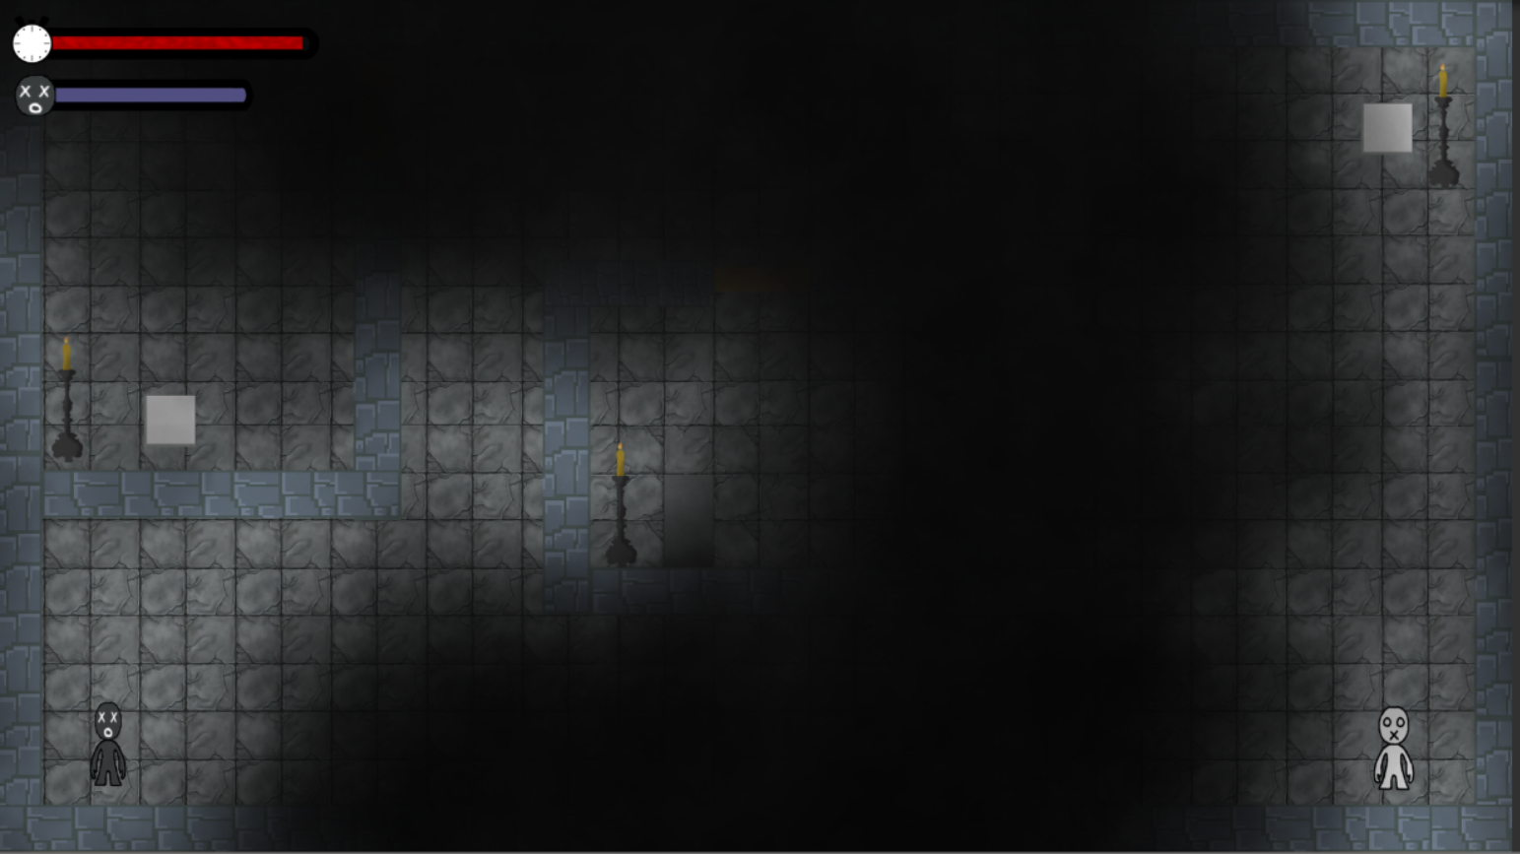
Group 16
John Dorman
River Chick
Charlie Kinglake
Lewis Wilden
Guy Zawada
Roberto Mitrea

Slide 2
Emotions
Onism
The frustration of being stuck in one body that inhibits one place at a time.
Occhilism
The awareness of the smallness of your perspective.

Slide 3
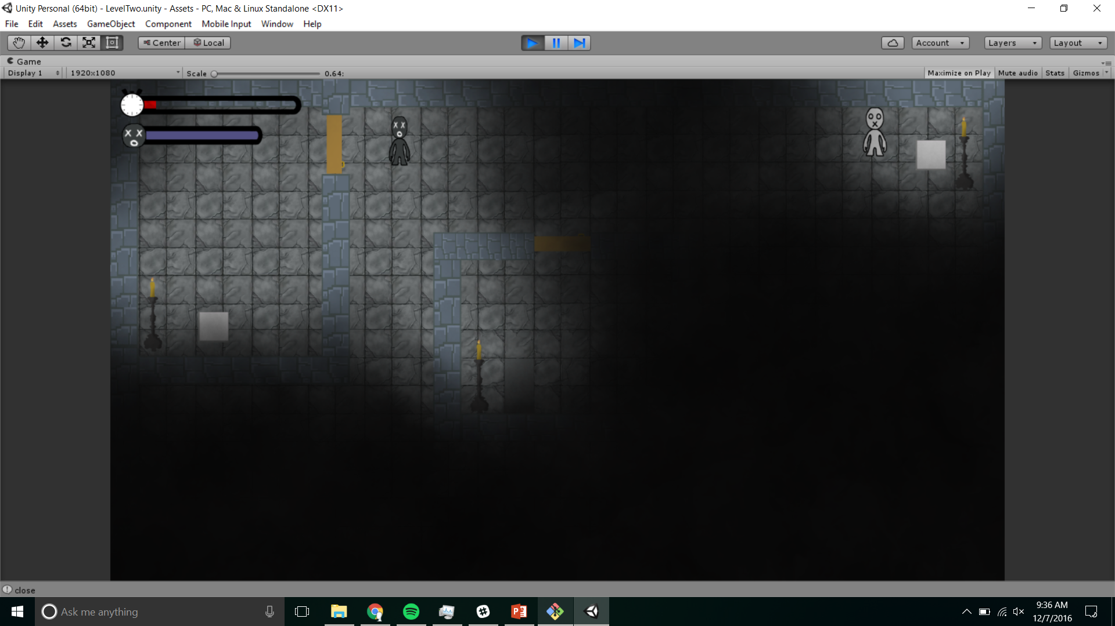
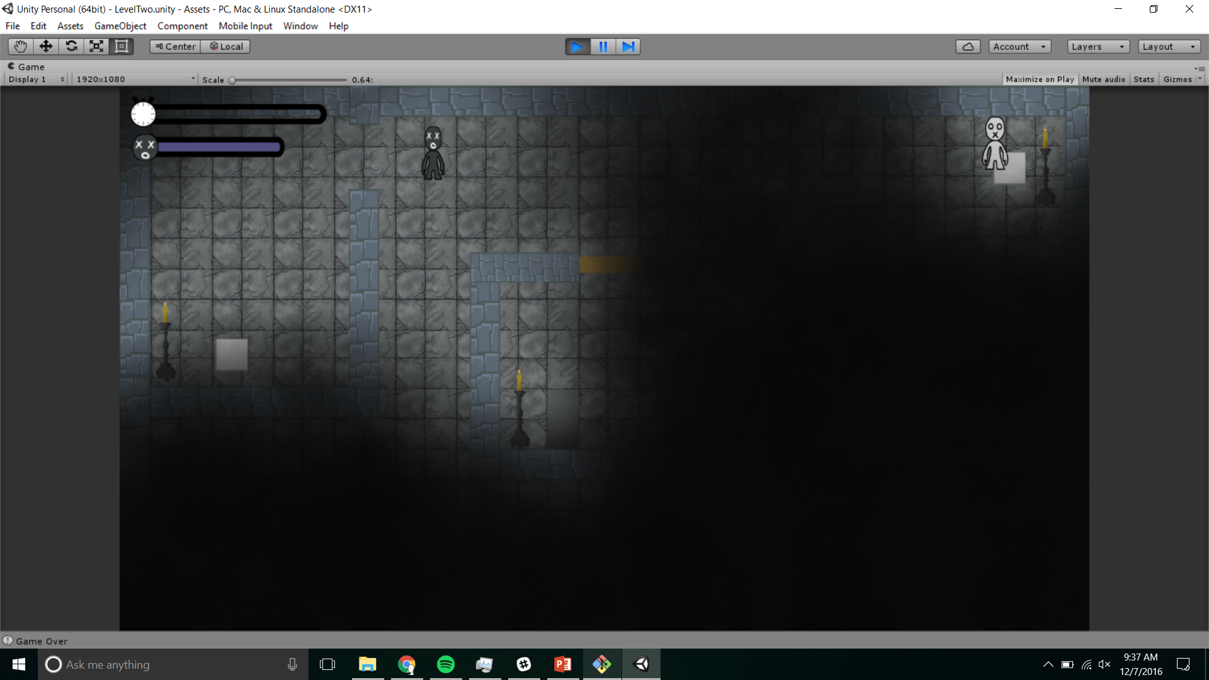
Puzzles

Slide 4
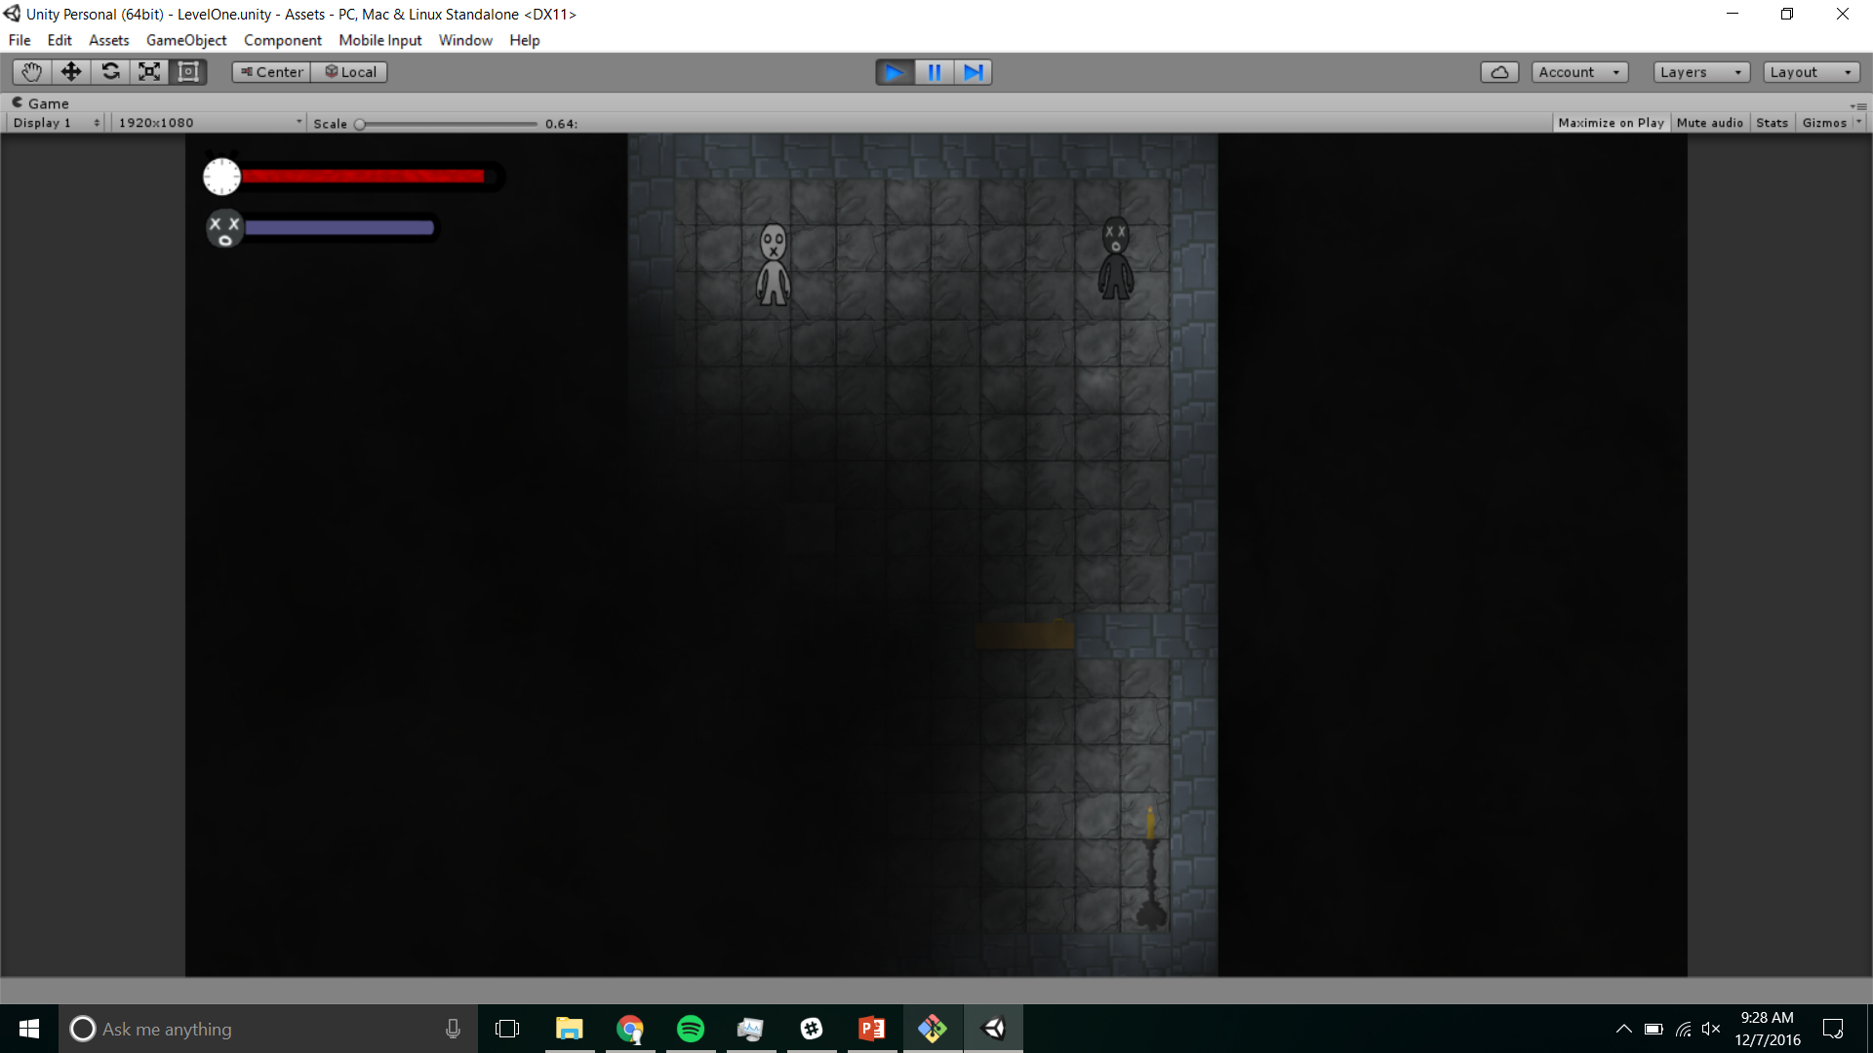
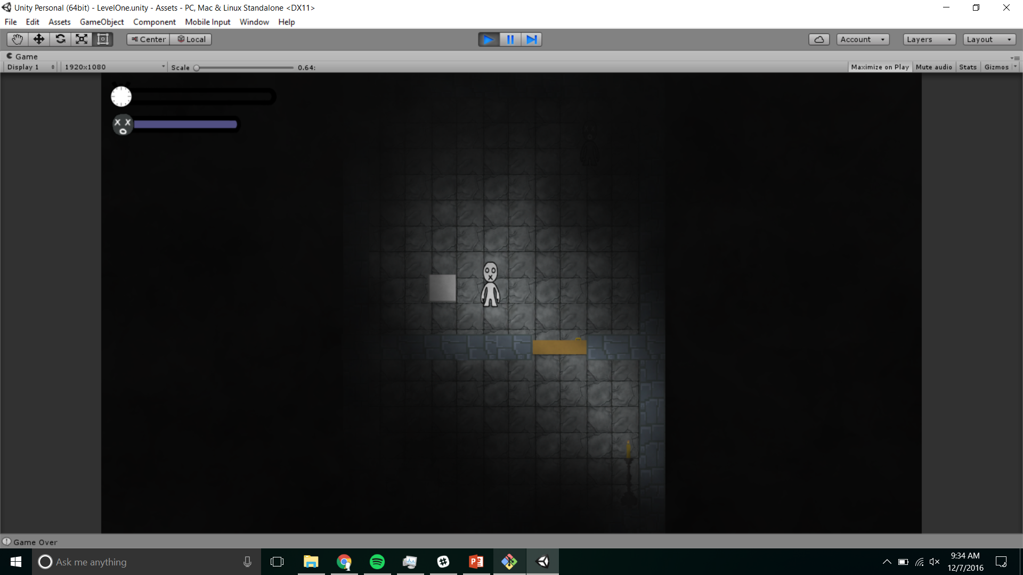
Exploration

Slide 5
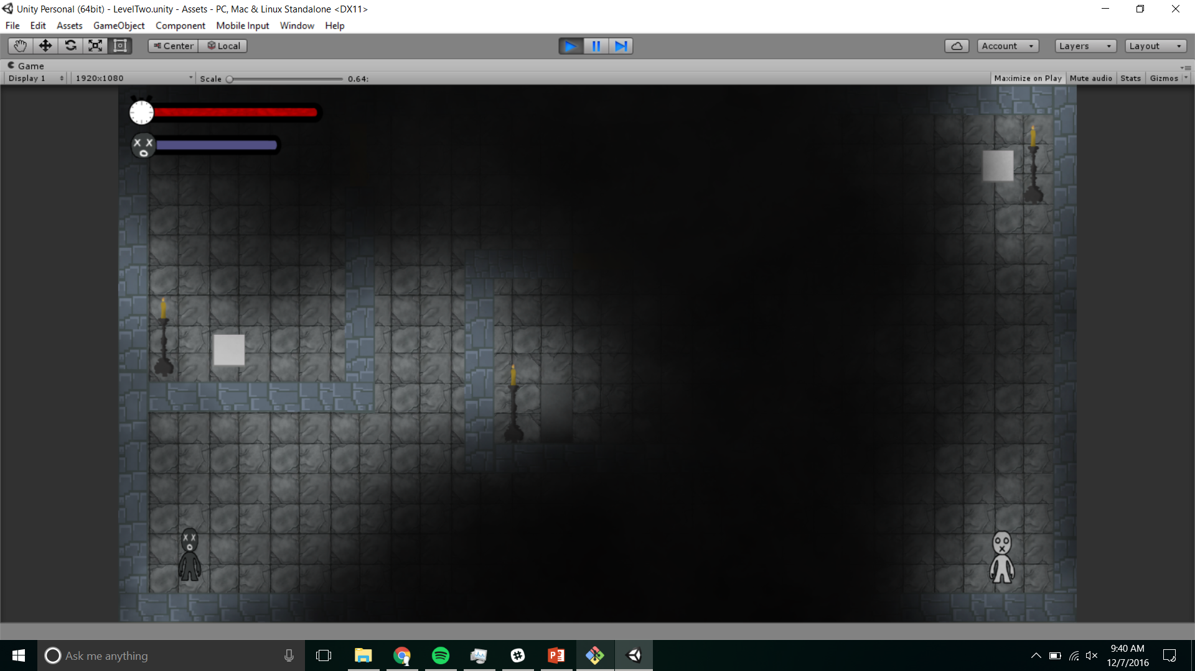
Level Timer

